Slide 1
VizFit
Noah Buchanan, Sam Donaldson,
Sasha Lawson, Alana Matheny

Slide 2
Introduction

Slide 3
Team Members
Alana Matheny
Background
Artificial Intelligence
Computer Graphics
Information Retrieval
Noah Buchanan
Background
Artificial Intelligence
Machine Learning
Deep Learning
Information Retrieval
IoT
Sam Donaldson
Background
Artificial Intelligence
Computer Graphics
Deep Learning
ArcBest Developer Intern
Sasha Lawson
Background
Artificial Intelligence
Computer Graphics
Machine Learning
ArcBest Developer Intern

Slide 4
Problems Facing Fitness
Lack of Insight
Cannot aim fitness routines toward personal or medical goals
Failure to be Consistent
Can’t go to the gym
Not convenient
Proper Fitness is Difficult
Could over exercise
Incur injury from improper technique

Slide 5
Development

Slide 6
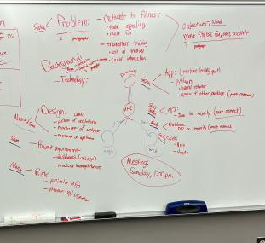
Planning
3 Major Sections
Website
Wireframe Model
Exercise Recognition
Regular Checkup and Planning Meetings
Increased as needed to meet weekly demands

Slide 7
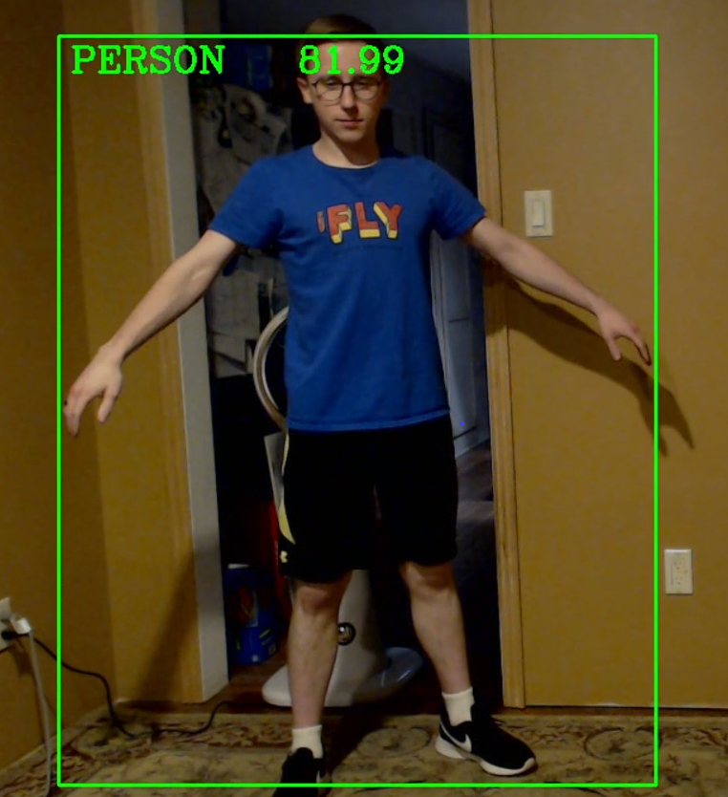
Implementation
Trial, Error, Rework
Wireframe Model
Exercise Recognition
Website & Python GUI
Followed Leads and Determining Worth
Different model architecture designs
Bounding box
Tkinter

Slide 8
Technology
MySQL
Relational database management system
Java & Spring
Create back-end RESTful API built on Java
Python
Implement various packages to create a computer vision based machine learning model
PyQt5 - GUI builder
OpenCV - Access webcam
TensorFlow - Access various datasets and create neural networks
Vue.js & Vuetify
Framework for constructing user interfaces and front-ends using “pre-built” components

Slide 9
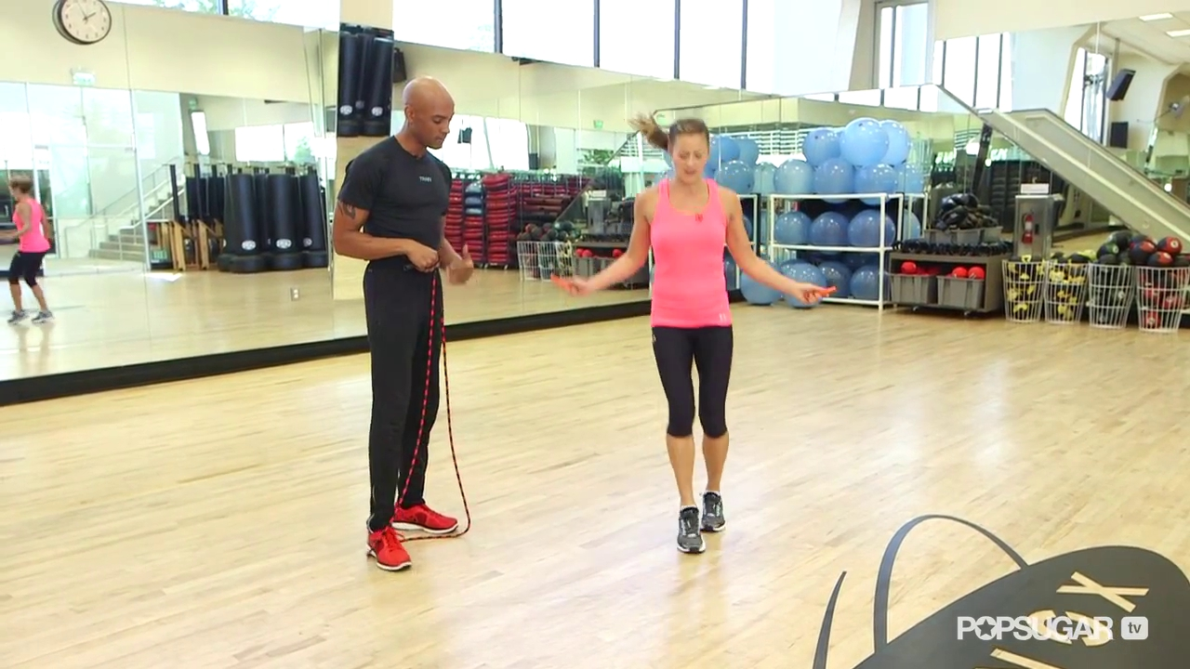
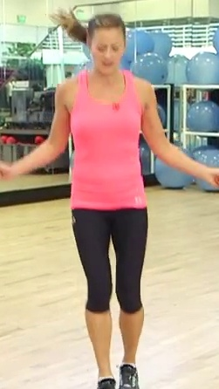
Model Testing & Development
Training Data:
All training image pixel values scaled from 0 - 255 to 0 - 1
Images are cropped around annotated person in image
In practice, a bounding box neural network is used to crop a live feed of image data

Slide 10
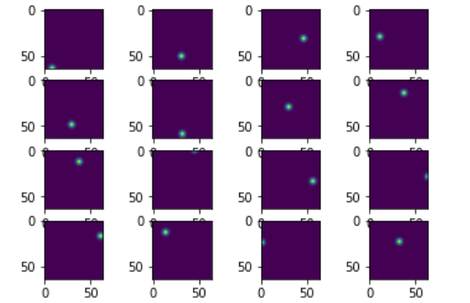
Model Testing & Development (cont.)
Target output:
16 keypoint coordinates translated into 16 heatmaps of size 64 x 64
Gaussian blurring to generate heatmap
Heatmaps also consist of scaled values 0 - 1
[ [x1,y1], [x2,y2], …. , [x16,y16] ]

Slide 11
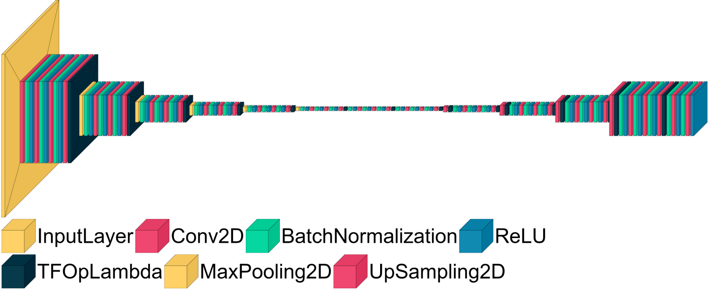
Model Testing & Development (cont.)
Hourglass module:

Slide 12
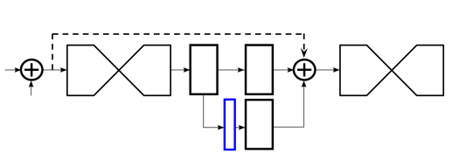
Model Testing & Development (cont.)
Entire model architecture includes 8 stacked hourglass modules
Intermediate supervision between adjacent hourglass modules
Output from hourglass is mapped to dimensions of 16 x 64 x 64 through convolution layers so that MSE loss can be applied
Once loss has been applied we map it back to the original dimensions and add with the residual connection from before the current hourglass and the unmapped output

Slide 13
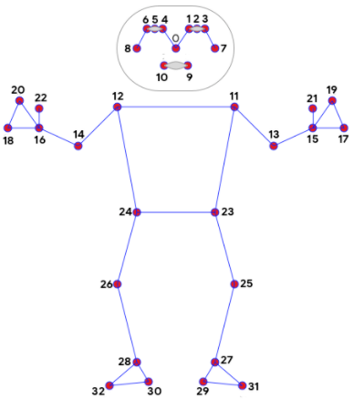
Exercise Testing & Development
Push-Ups
Main Angle: Elbow
Special Case: Upside Down push-up
Sit-Ups
Main Angle: Hip
Squats
Main Angle: Knee
Special Case: Arms Out checker

Slide 14
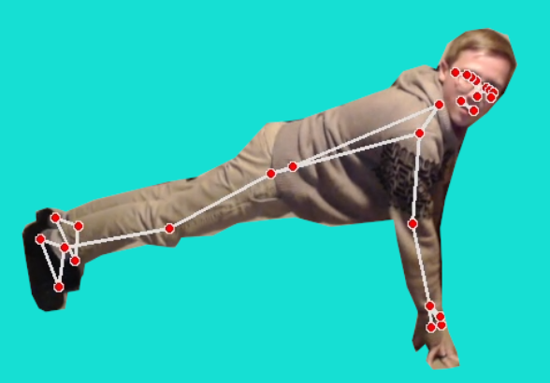
Exercise Testing & Development (cont.)
Initial Testing

Slide 15
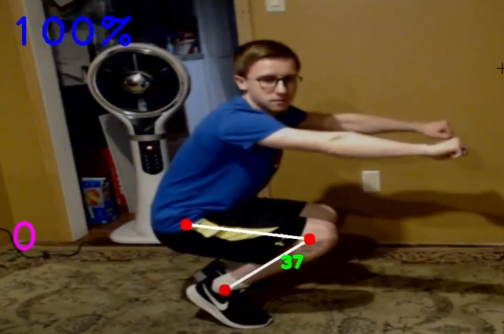
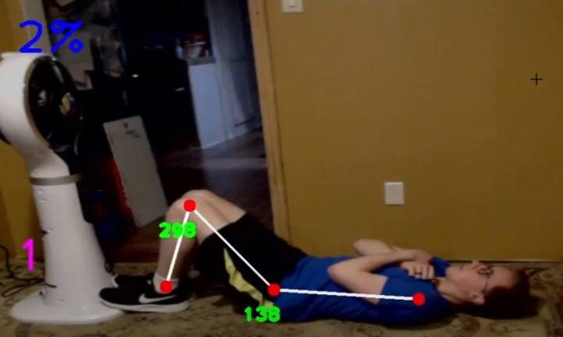
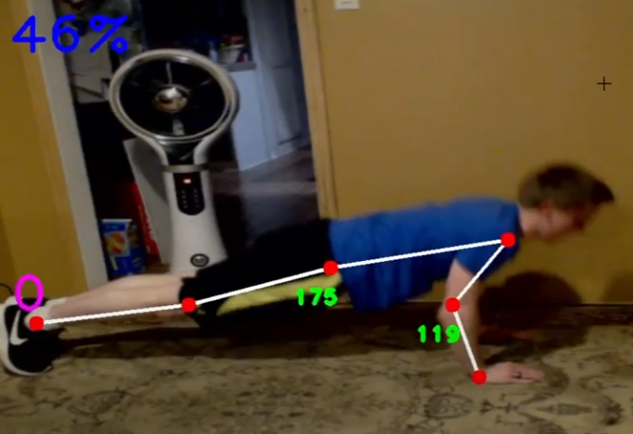
Exercise Testing & Development (cont.)
Initial Specific Exercise Testing
Squats
Sit-Ups
Push-Ups

Slide 16
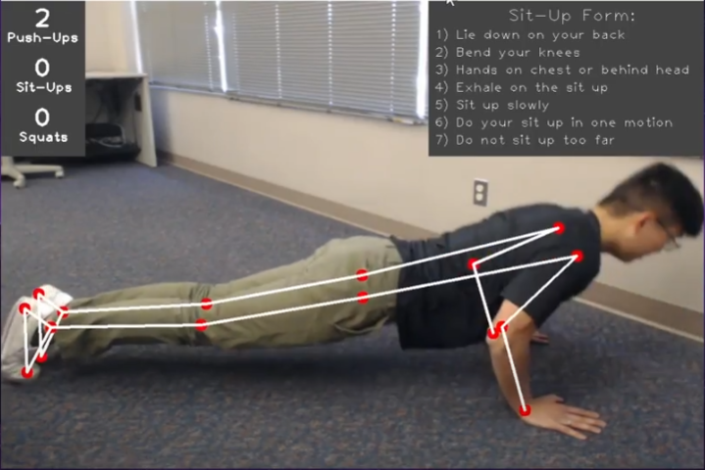
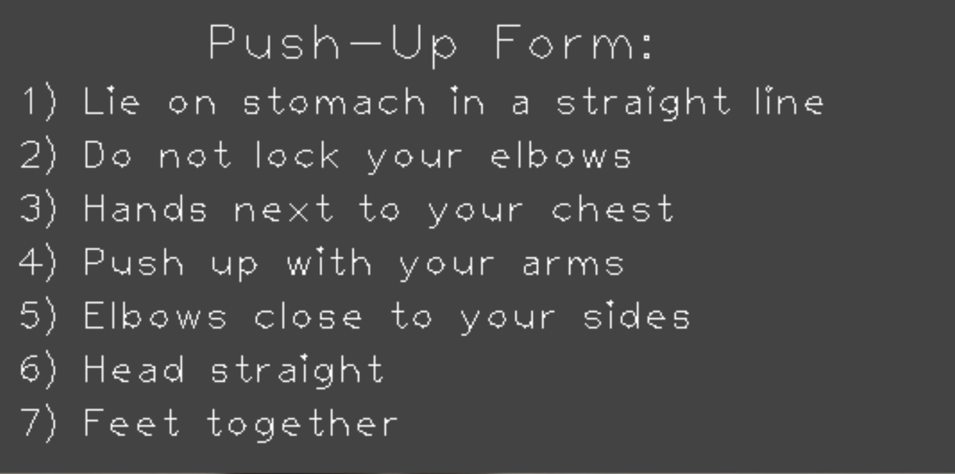
Exercise Testing & Development (cont.)
UI & Exercise Recognition

Slide 17
Exercise Testing & Development (cont.)
Other Highlights
Left Facing v. Right Facing
Angle had to be inverted to account for the opposite direction
Duration System
Ensured that points weren’t added for being in the correct position
Set variable “duration” back and forth between 0 and 1
In Frame Checker
Checks whether the wireframe can fully map onto the body based on if its in frame

Slide 18

Exercise Recognition Demo - Push-ups

Slide 19
Exercise Recognition Demo - Sit-ups

Slide 20
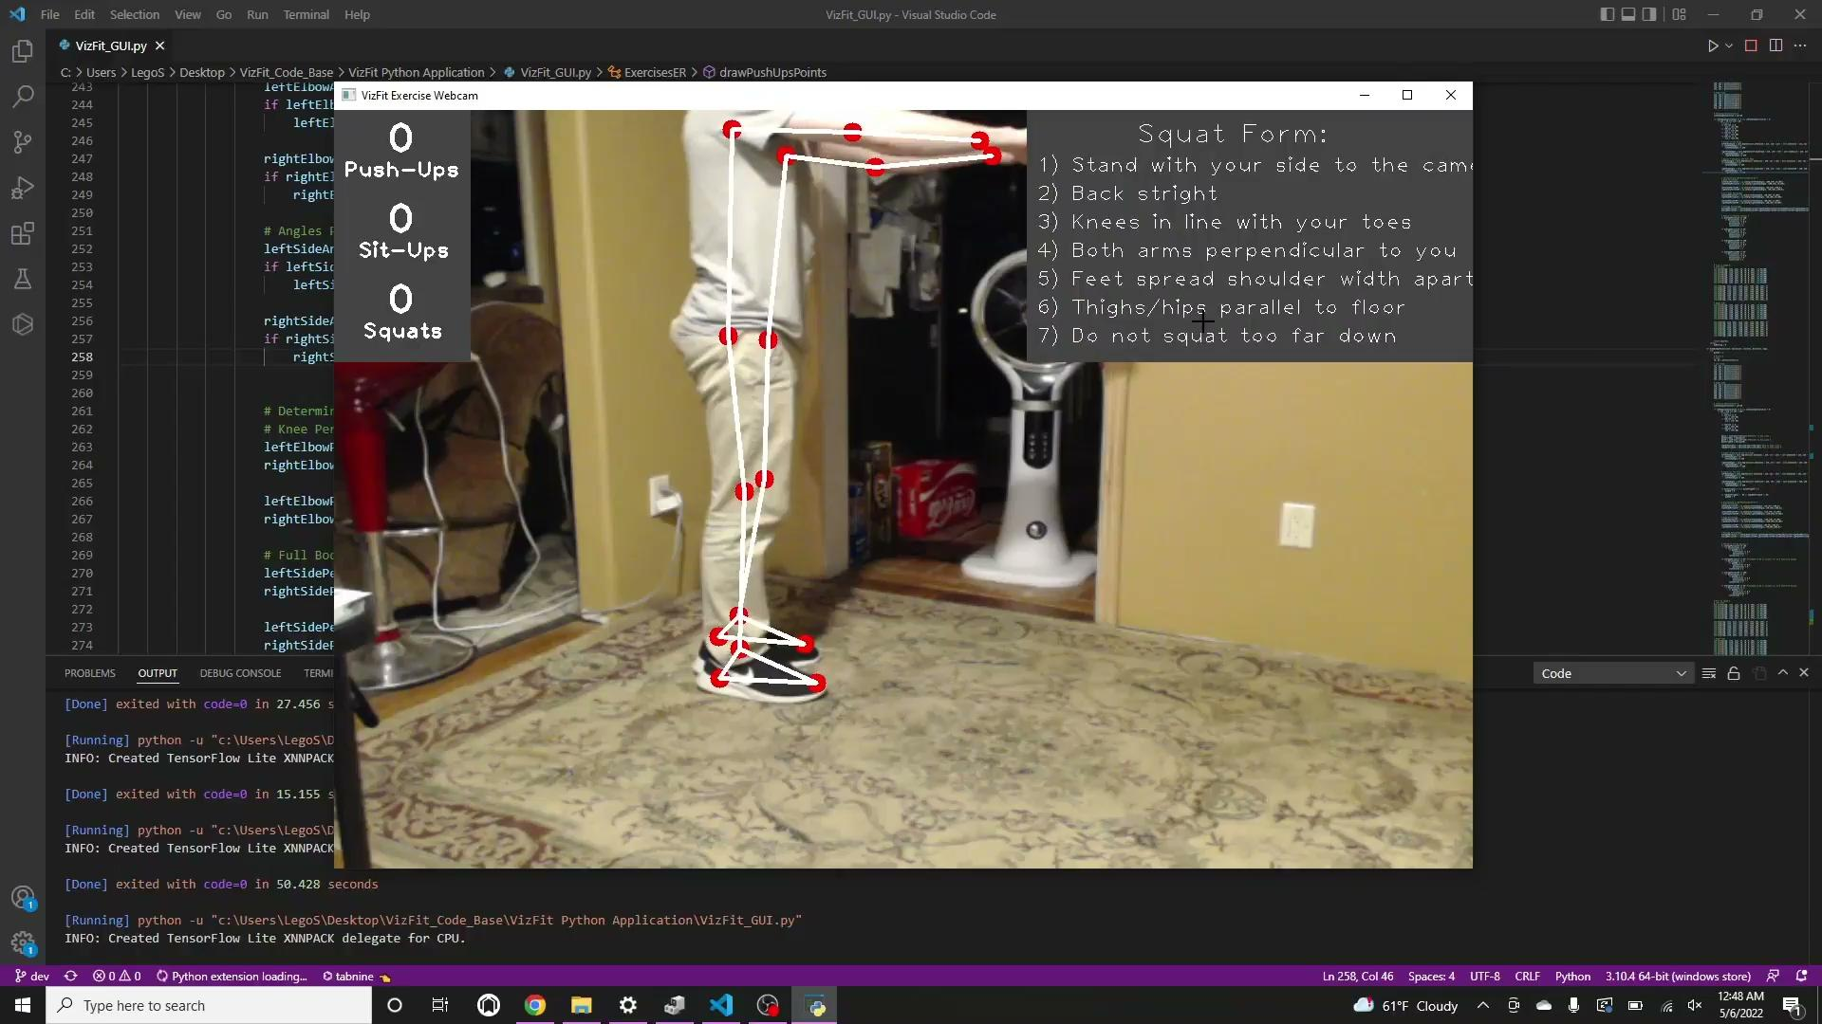
Exercise Recognition Demo - Squats

Slide 21
Design Overview

Slide 22
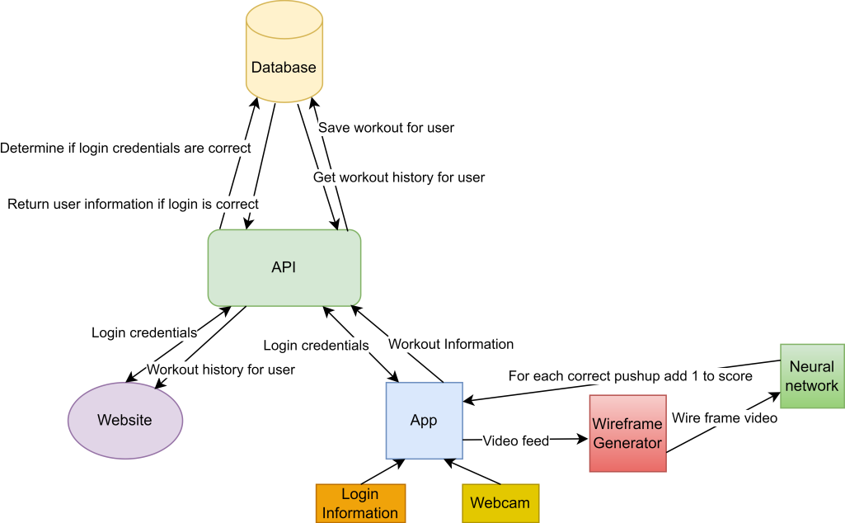
Architecture

Slide 23
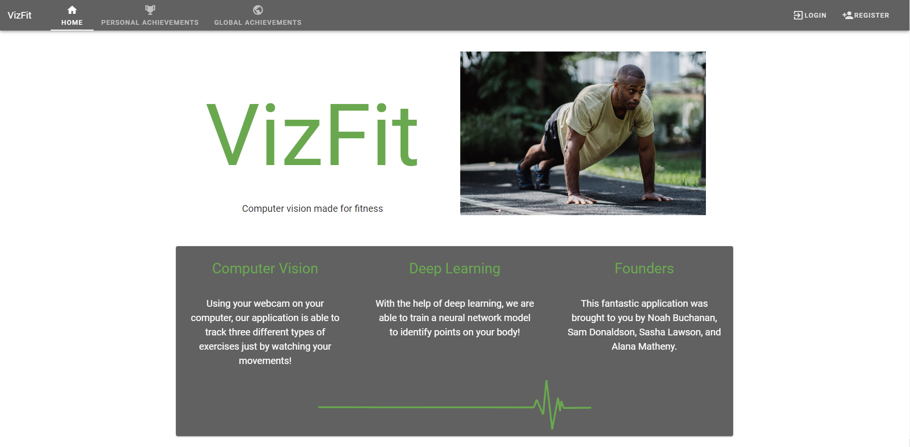
Website - Homepage

Slide 24
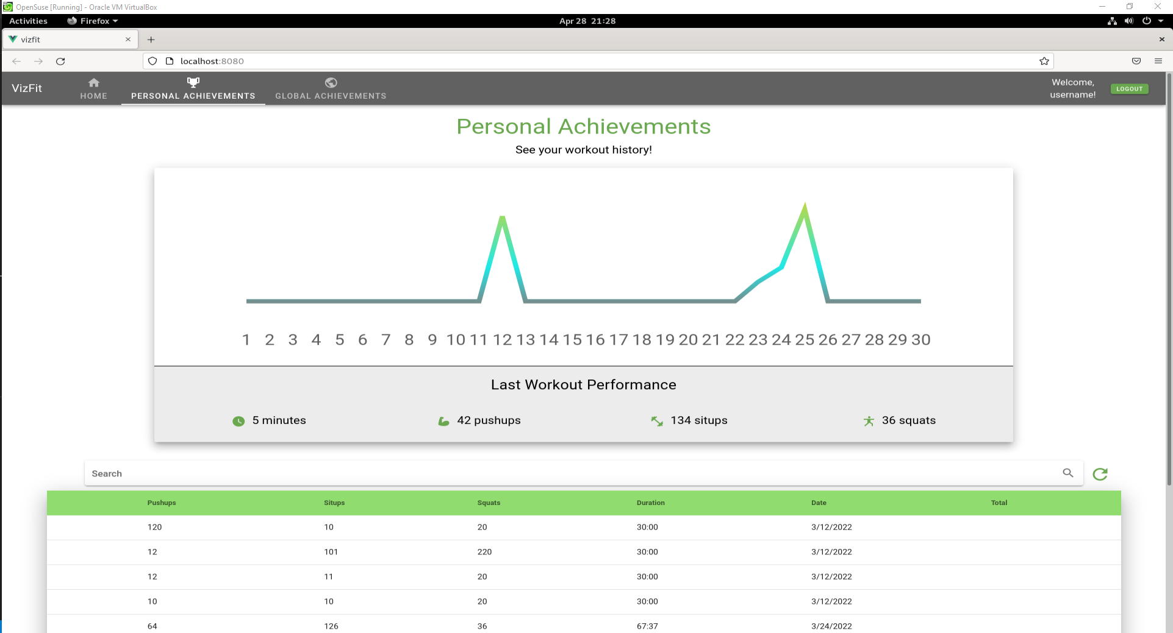
Website - Personal Analytics

Slide 25
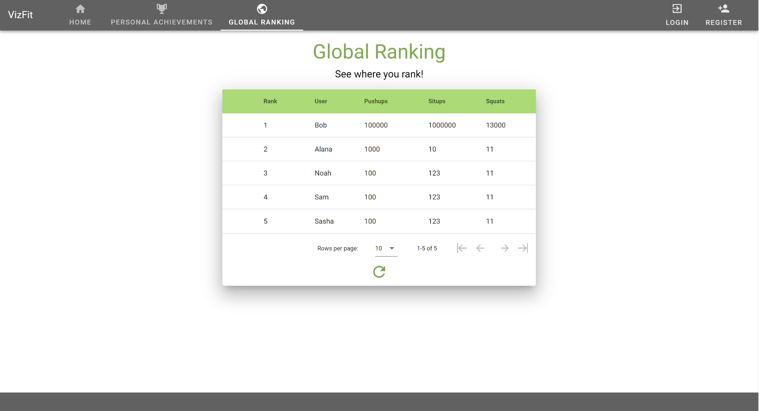
Website - Global Ranking

Slide 26
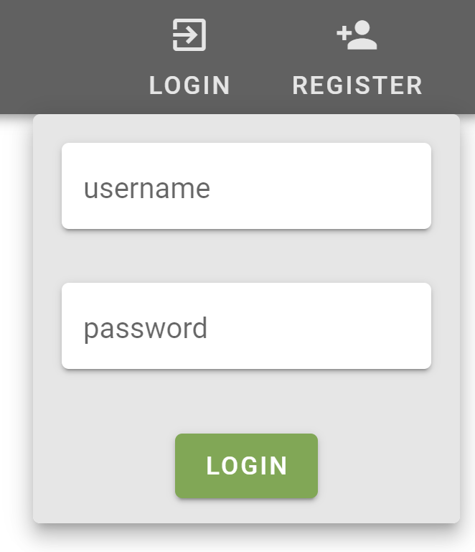
Website - Login

Slide 27
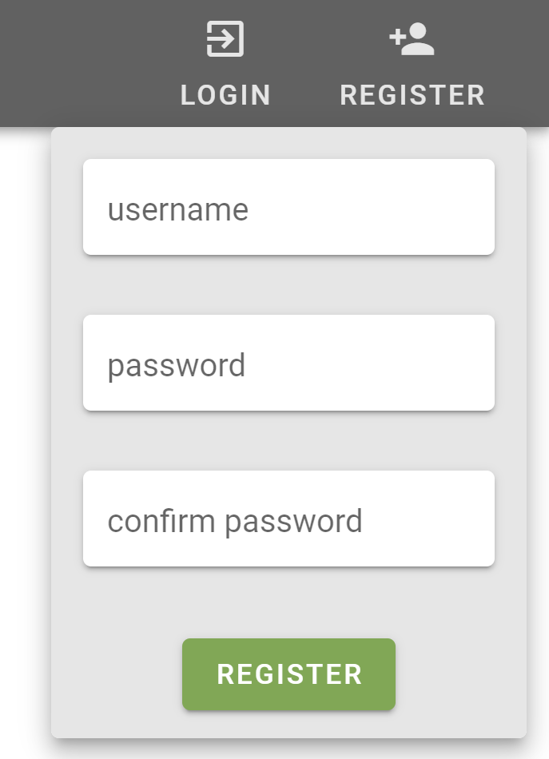
Website - Register

Slide 28
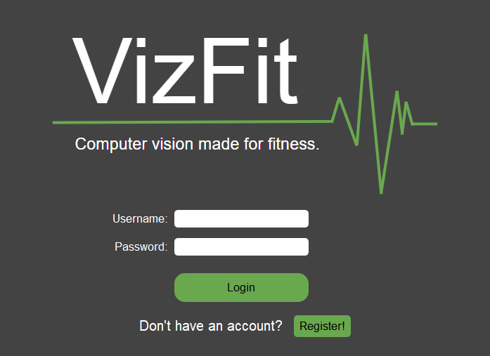
GUI - Home

Slide 29
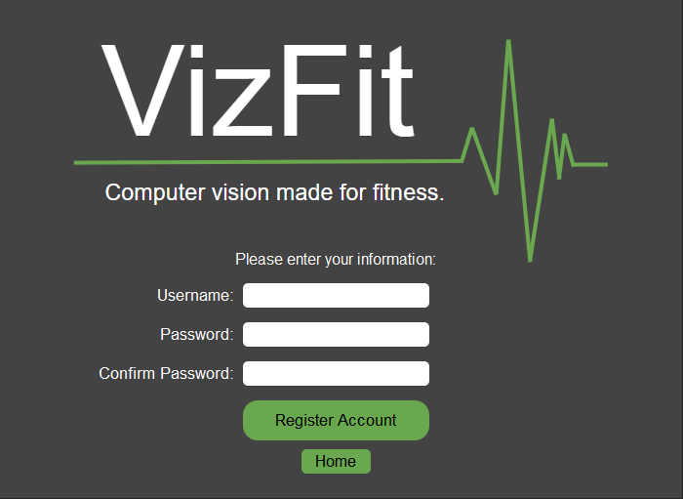
GUI - Register

Slide 30
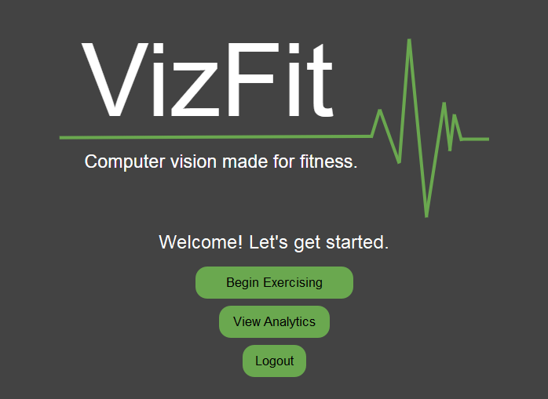
GUI - Welcome

Slide 31
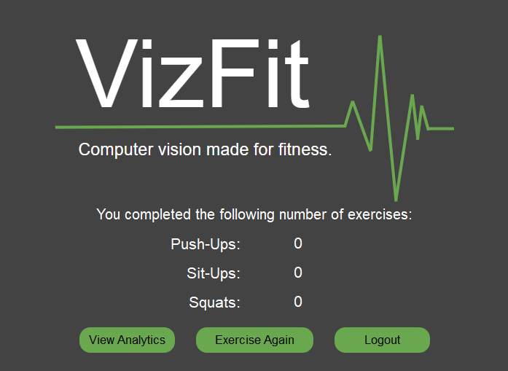
GUI - Results

